Slide 1
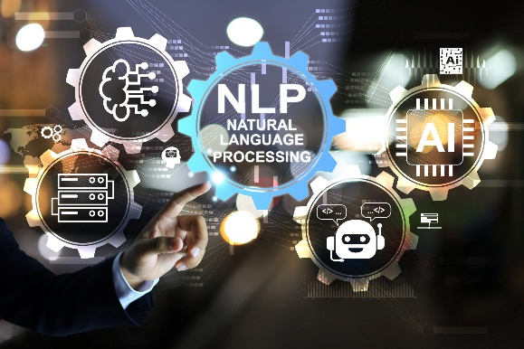

Dr. Muzamil Ahmed (Assistant Professor) Namal University Mianwali
Natural Language Processing
Introduction to NLP, Applications & Project-Oriented Learning

Slide 2

Lesson from Quran

Slide 3

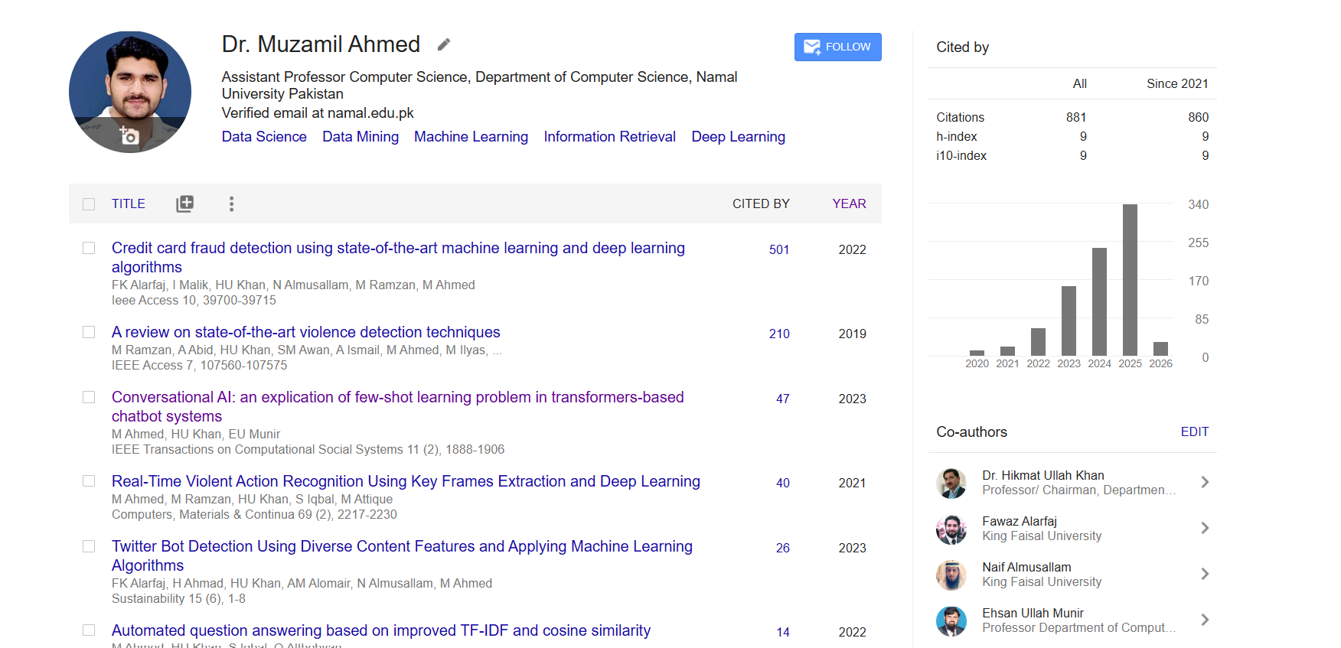
Google Scholar Profile
https://scholar.google.com.pk/citations?user=wIdOTn8AAAAJ&hl=en

Slide 4

Lecture Outline
Introduction to NLP
Scope of NLP
Linguistic foundations
Evolution of methods
Core NLP applications
Course structure
Project expectations
Industry and research relevance

Slide 5
Course Orientation & Vision
This course covers the complete NLP spectrum:
Text preprocessing and linguistic foundations
Statistical text representations (BoW, TF-IDF)
Word embeddings (Word2Vec, GloVe, FastText)
Neural sequence models (RNN, LSTM, GRU)
Attention mechanisms
Transformer architecture
Pretrained language models (BERT, GPT)
Fine-tuning and alignment
Evaluation, ethics, deployment

Slide 6

What is Natural Language?
Natural language is:
Discrete yet structured
Hierarchical
Context-sensitive
Ambiguous
Sequential but not strictly Markovian
Unlike programming languages:
No fixed grammar
Meaning depends on pragmatics
Requires world knowledge
Notes:
1. Discrete yet Structured Language consists of separate words arranged in grammatical structure. Example: “AI improves healthcare.” (Clear subject–verb–object structure)
2. Hierarchical Sentences contain nested phrases and clauses. Example: “The student [who won the award] is happy.”
3. Context-Sensitive Meaning depends on surrounding context. Example: “It’s hot.” (Statement or request to turn on AC)
4. Ambiguous A sentence may have multiple interpretations. Example: “I saw her duck.” (She lowered her head / She owns a duck)
5. Sequential but Not Strictly Markovian Words are sequential, but dependencies may span long distances. Example: “The keys on the table are missing.” (Verb agrees with “keys”)
6. No Fixed Grammar Rules are flexible and evolve over time. Example: Informal forms like “gonna” are understood.
7. Pragmatic Meaning Meaning depends on speaker intention. Example: “Can you open the window?” (Request, not ability question)
8. Requires World Knowledge Understanding relies on real-world understanding. Example: “She put ice in the drink to cool it.”

Slide 7

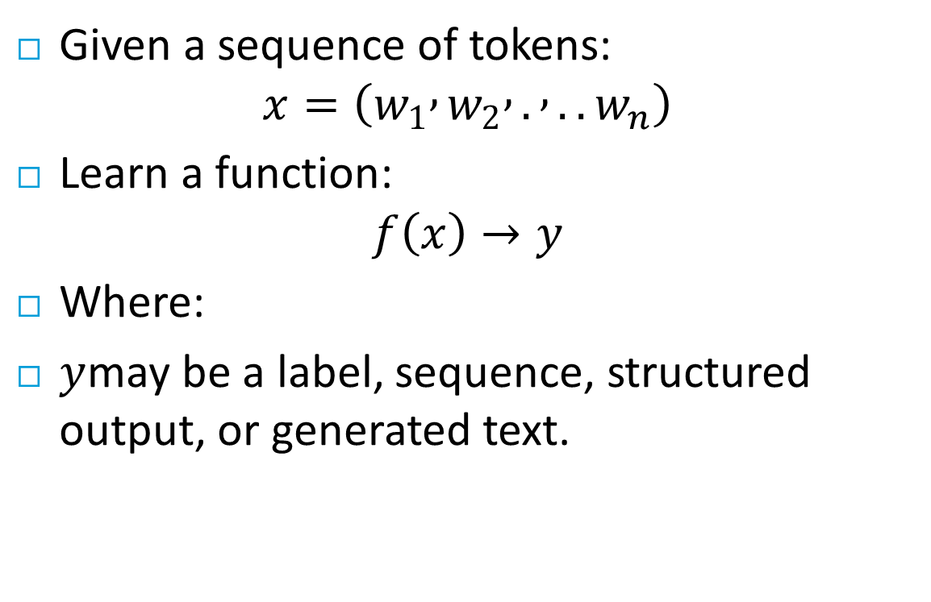
Core NLP Objective
Given a sequence of tokens:
$$x=\left(w_{1} , w_{2} , . , ..w_{n}\right)$$
Learn a function:
$$f\left(x\right)→y$$
Where:
$y$may be a label, sequence, structured output, or generated text.

Slide 8
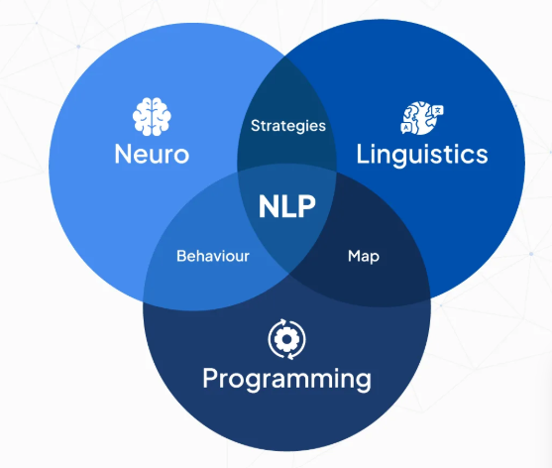
Formal Definition of NLP
NLP is the study of:
Computational modeling of language
Statistical learning over text
Representation learning for linguistic units
Sequence-to-sequence transformation
It combines:
Linguistics
Probability theory
Linear algebra
Optimization
Deep learning
NLP is about using math and machine learning to make computers understand and generate human language.

Slide 9
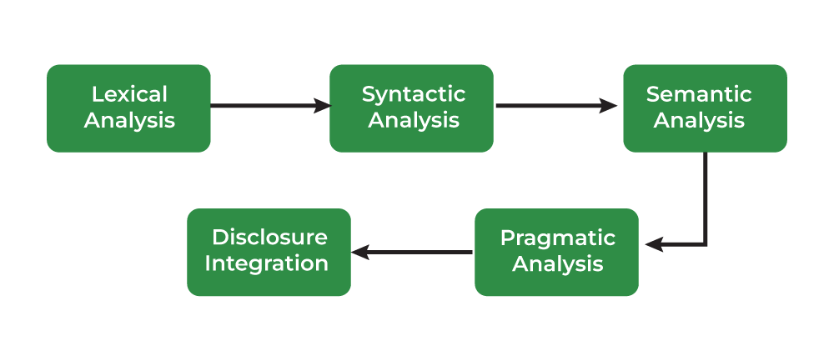
Linguistic Levels in NLP
Language operates at multiple levels:
Phonology: Sound structure (mainly speech systems)
Example: “cat” vs “bat” or “ice cream” vs “I scream”
Morphology: Word formation
Example:“unhappiness” → un + happy + ness
Syntax: Grammatical structure
Parse trees, dependency trees
Semantics: Meaning representation
Pragmatics: Contextual meaning
Example: “Can you pass the salt?”
Modern LLMs attempt to implicitly learn all levels jointly.

Slide 10
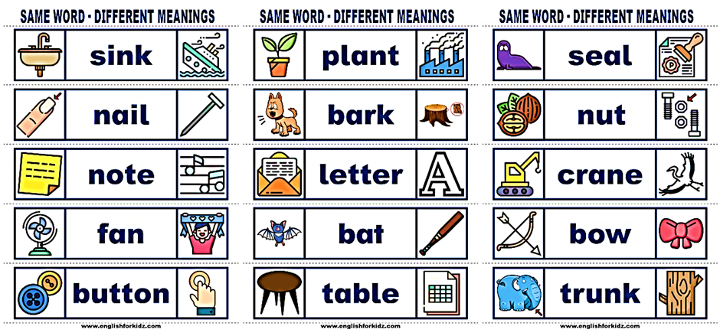

Why NLP is Hard
Ambiguity
Lexical ambiguity: “bank” (financial vs river)
Syntactic ambiguity: “I saw the man with a telescope.”
Multiple valid parse trees.
Long-Range Dependencies
Example:
The book that the professor who the students admired wrote was published.
Dependency spans long distances.
Compositionality
Meaning of sentence ≠ simple sum of words.

Slide 11
Ambiguity in sentence level
“Finally, a computer that understands you like your mother”
The computer understands you as well as your mother understands you.
The computer understands that you like your mother.
The computer understands you as well as it understands your mother.

Slide 12
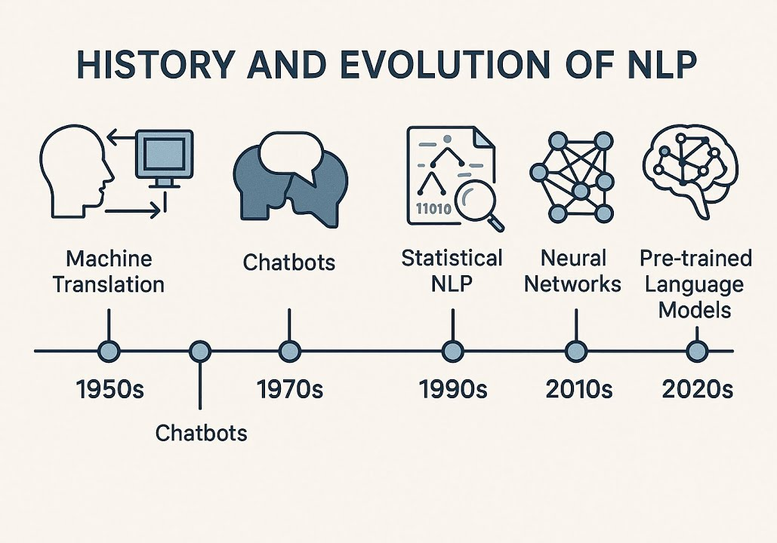
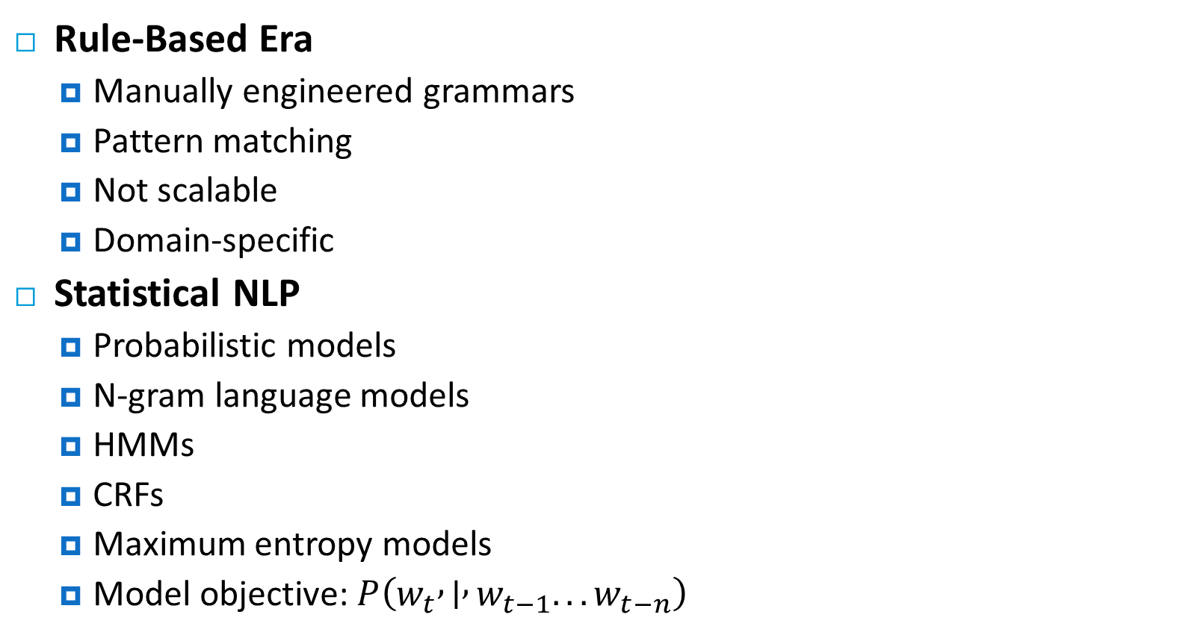
Evolution of NLP
Rule-Based Era
Manually engineered grammars
Pattern matching
Not scalable
Domain-specific
Statistical NLP
Probabilistic models
N-gram language models
HMMs
CRFs
Maximum entropy models
Model objective: $P\left(w_{t} , ∣ , w_{t−1}...w_{t−n}\right)$
Notes:
Probabilistic Models
Instead of: “If X then Y”
We model:
Probability of Y given X
N-gram Language Models
Predict next word using previous words.
Hidden Markov Models (HMMs)
Used for:
Part-of-speech tagging
Speech recognition
CRFs
“New York City”
CRF ensures: B-LOC → I-LOC → I-LOC
Probability of current word given previous n words.

Slide 13
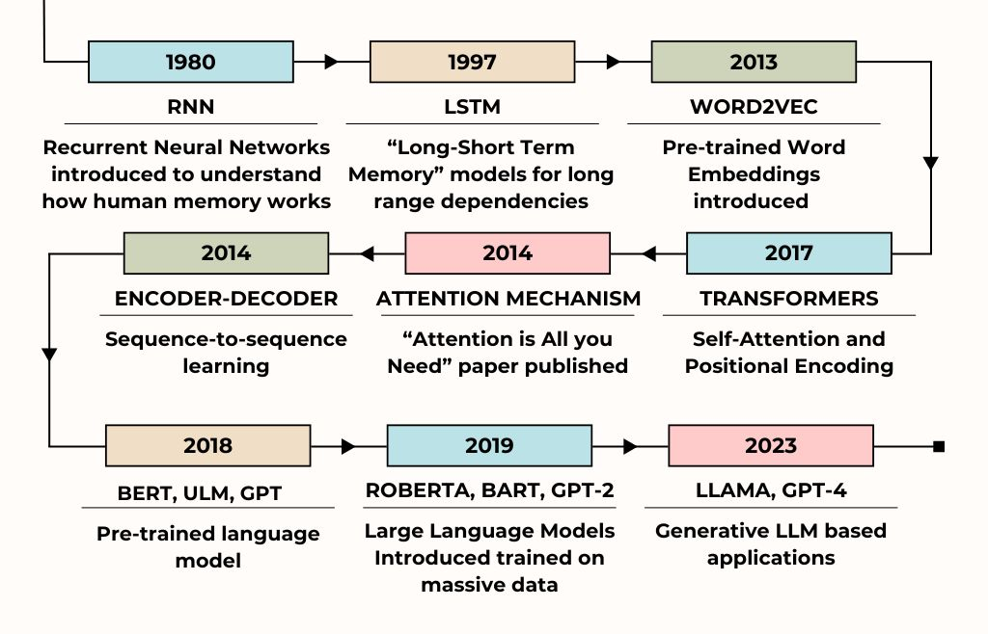
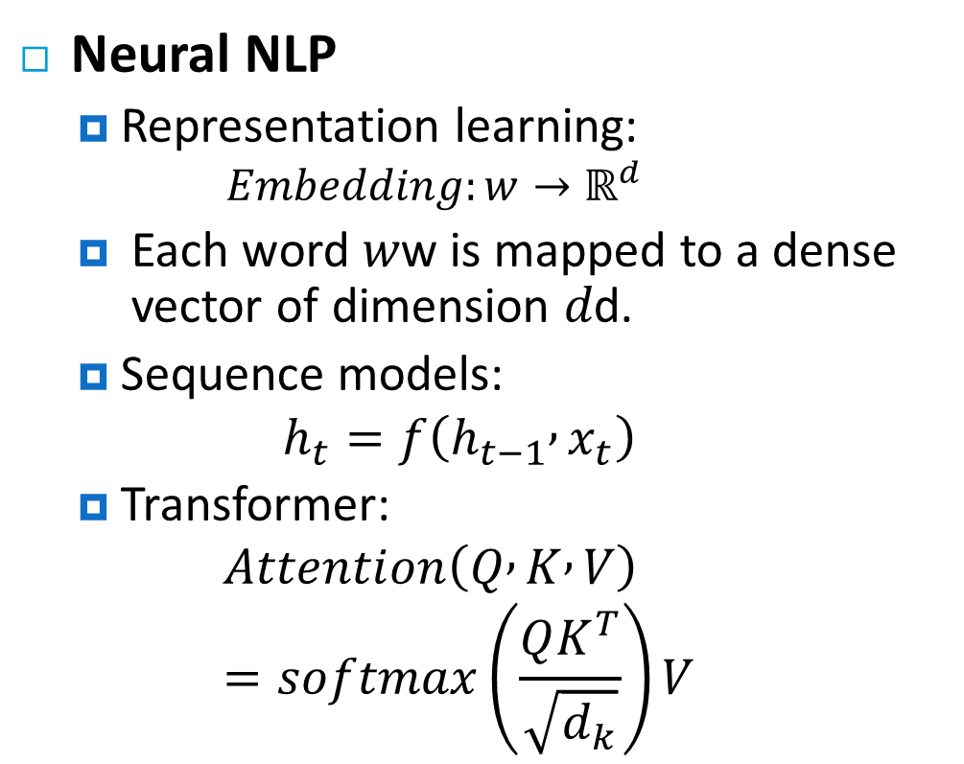
Evolution of NLP
Neural NLP
Representation learning:
$$Embedding:w→ℝ^{d}$$
Each word 𝑤w is mapped to a dense vector of dimension 𝑑d.
Sequence models:
$$h_{t}=f\left(h_{t−1} , x_{t}\right)$$
Transformer:
$$Attention\left(Q , K , V\right)=softmax\left(\frac{QK^{T}}{\sqrt{d_{k}}}\right)V$$
Notes:
Step-by-Step Explanation:
Compute similarity:
$$QK^{T}$$
Measures how relevant each word is to another.
Scale:
$$\frac{QK^{T}}{\sqrt{d_{k}}}$$
Prevents large values that destabilize softmax.
Apply Softmax: Produces attention weights (probability distribution).
Multiply with V: Generates weighted combination of values.

Slide 14
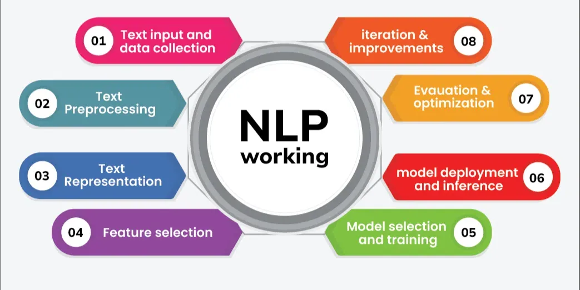
Modern NLP Pipeline (Technical View)
Step 1: Data Collection
Web scraping
APIs
Public datasets
Step 2: Text Cleaning
Lowercasing
Removing noise
Normalization
Step 3: Tokenization
Word-level
Subword-level (BPE, WordPiece)

Slide 15
Modern NLP Pipeline (Technical View)
Step 4: Representation
Sparse vectors (BoW)
Dense embeddings
Step 5: Modeling
Linear models
Neural networks
Transformers
Step 6: Evaluation
F1
BLEU
ROUGE
Perplexity

Slide 16
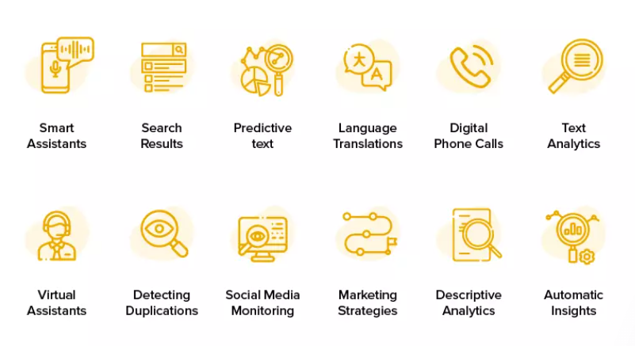
Applications of NLP

Slide 17
NLP in Customer Service (Real-World Value)
Chatbots & Virtual Assistants
NLP powers automated conversational agents that understand customer queries in real time.
Bots can handle FAQs, automate responses, and escalate complex issues to humans.
Improves response time and scales support operations efficiently.
Sentiment Analysis
NLP models analyze customer feedback and social media to extract emotional tone.
Helps brands monitor satisfaction and identify pain points.
Personalized Recommendations
Analyze past interactions and preferences to suggest products or services.
Enhances user engagement and boosts sales.
Project idea: Create an NLP-based recommender for an e-commerce dataset.

Slide 18
NLP in Healthcare
EHR Analysis & Clinical Documentation
NLP extracts structured data (diagnoses, symptoms, treatments) from large, unstructured medical records.
Speeds clinician access to patient insights.
Drug Discovery & Research Mining
Scans scientific publications and trial reports to find hidden correlations.
Helps accelerate discovery cycles.
Mental Health & Telemedicine
Detects linguistic markers of distress or depression in patient communication.
NLP-powered transcription tools turn verbal consultations into reliable digital records.

Slide 19
NLP in Finance
Fraud Detection & Risk Management
Systems analyze communication patterns and transaction data for anomalies that indicate fraud.
Risk teams draw insights from unstructured news & regulatory reports.
Algorithmic Trading & Sentiment-Driven Signals
NLP interprets market news and social sentiment to guide trading models.
Projects can explore news-to-sentiment-to-price models.
Financial Summarization
Automatically generates concise summaries of lengthy financial documents.
Useful for analysts and investors.

Slide 20
NLP in Education
Automated Essay Scoring
Evaluates grammar, logic, and coherence using NLP scoring models.
Reduces instructor workload and standardizes scoring.
Personalized Learning Platforms
Learner profiling via responses and performance analysis.
Recommends tailored study paths.
Language Learning Tools & Chatbots
Speech recognition and grammar correction integrated into language apps (e.g., Duolingo).
24/7 homework help bots extend learning.

Slide 21
NLP in Legal Systems
Contract Clause Extraction
Identifies and highlights critical clauses, obligations, and risks.
Speeds due diligence.
Document Review & E-Discovery
Automates review of case files, emails, legal briefs to find relevant evidence.
Saves hours in litigation and regulatory work.
Legal Research Acceleration
Improves retrieval of relevant case laws and precedents beyond keyword search.

Slide 22
NLP in Manufacturing
Predictive Maintenance
NLP processes maintenance logs and sensor descriptions to predict equipment failure.
Reduces downtime and operational costs.
Quality Control & Inspection Reports
Automatically detects patterns in production logs and human feedback for defect types.
Supply Chain Management Intelligence
Extracts key insights from suppliers’ contracts, purchase orders, and logistics docs.

Slide 23
NLP in Media & Entertainment
Content Recommendation Engines
Models viewing and listening patterns for personalized suggestions.
News & Video Summarization
Condenses large news feeds or video transcripts into brief insights.
Sentiment Analysis of Reviews
Studios analyze audience sentiment to influence marketing and production decisions.

Slide 24
NLP in Government & Public Services
Government Data Accessibility
Transforms complex regulations and datasets into simpler summaries for citizens.
Public Engagement via Chatbots
Virtual assistants answer service queries and guide citizens through procedures.
Opinion Mining for Policy Decisions
Analyzes public sentiment regarding policies, welfare programs, and national announcements.

Slide 25
NLP in Travel & Tourism
Booking & Travel Assistance Bots
Provide automated support for flight, hotel, and itinerary planning.
Personalized Itineraries
Uses preferences and past travel searches to recommend tailored journey plans.
Review Aggregation & Multilingual Assistance
NLP groups traveler feedback to highlight top attractions and helps break language barriers with real-time translation.

Slide 26
NLP in National Security & Law Enforcement
Threat Detection on Social Platforms
NLP flags extremist or high-risk content based on linguistics signals.
Crime Text Pattern Analysis
Processes police reports and evidence text to find trends and predict hotspots.
Cyber Threat Detection
Detects phishing content and malicious patterns in communication data.

Slide 27
Project-Oriented Learning
NLP is experimental.
Understanding requires:
Dataset engineering
Hyperparameter tuning
Error analysis
Model comparison
You must experience:
Training instability
Overfitting
Dataset bias
Evaluation pitfalls

Slide 28
Project Structure (Aligned with Units)
Milestone 1
Problem definition + dataset exploration
Milestone 2
Baseline statistical model
Milestone 3
Neural model
Milestone 4
Transformer-based model + Generative AI
Milestone 5
Evaluation + deployment + report
This ensures progressive learning.

Slide 29
Choose Your NLP Project
Project Requirement
Solve a Complex Computational Problem
Your project must address a non-trivial NLP problem involving:
Large-scale text data
Advanced modeling (Neural Networks / Transformers/ Agentic AI)
Quantitative evaluation
Error analysis
Ethical consideration
Design, train, evaluate, and analyze an NLP model capable of solving a real-world language problem at research-level complexity.

Slide 30

Assessment & Evaluation
Continuous Assessments (30%)
Quizzes (5 marks)
Assignments (15 marks)
Project (5 marks)
CCP (5 marks)
Midterm Exam (30 marks)
Final Examination (40%)

Slide 31

Thanks

